Slide 1

SQL Analysis Report S&P 500 Stock Prices
Historical stock market data for current S&P 500 companies, from 2014-2017.

Slide 2
Dataset Description: Schema
Database: PortfolioProjects
Dataset Name: 'S&P 500 Stock Prices 2014-2017$'
Symbol → nvarchar(255) → null = TRUE
Date → datetime → null = TRUE
[open] → float → null = TRUE
High→ float → null = TRUE
Low→ float → null = TRUE
[close] → float → null = TRUE
Volume → float → null = FALSE

Slide 3
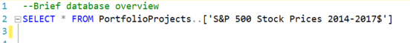
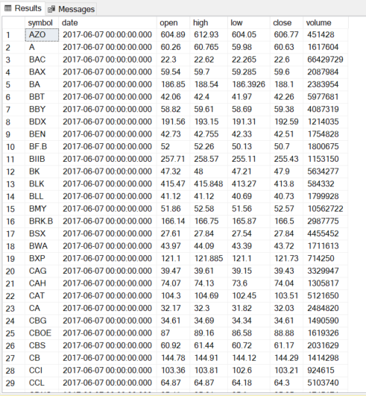
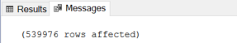
Data Explanation / GOAL
Main Goal is answering questions regarding stock data
Dataset
- 7 columns
- 539976 rows

Slide 4
Analysis Performed
Which date in the sample saw the largest overall trading volume? On that date, which two stocks were traded most?
On which day of the week does volume tend to be highest? Lowest?
On which date did Amazon (AMZN) see the most volatility, measured by the difference between the high and low price?
If you could go back in time and invest in one stock from 1/2/2014 - 12/29/2017, which would you choose? What % gain would you realize?
1
2
3
4

Slide 5
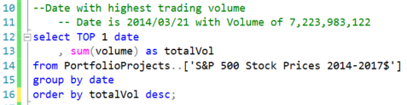
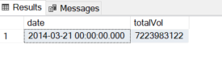
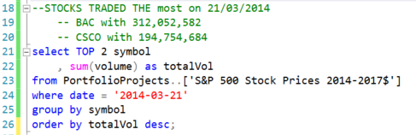
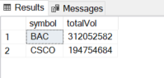
Which date in the sample saw the largest overall trading volume? On that date, which two stocks were traded most?
Breakdown of the query
- select the date with highest total (TOP 1) of aggregate (sum(volume) = totalVol)
- select the sum(volume) rename it as totalVol
- from dataset [‘S&P 500 Prices 2014-2017$’]
- located in database PortfolioProjects
- group the result by date
- order the result by totalVol in descending order
Breakdown of the query
- select the symbol with highest total (TOP 2) of aggregate (sum(volume) = totalVol)
- select the sum(volume) rename it as totalVol
- from dataset [‘S&P 500 Prices 2014-2017$’]
- located in database PortfolioProjects
- filter using where date is result from previous query
- group the result by symbol
- order the result by totalVol in descending order

Slide 6
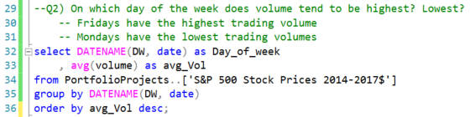
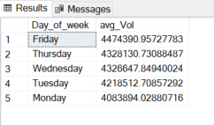
On which day of the week does volume tend to be highest? Lowest?
Breakdown of the query
- select the day from date. Use DATENAME() function to extract the day of the week.
- Rename aggregate DATENAME(DW, date) as Day_of_week
- select the avg(volume) rename it as avg_Vol
- from dataset [‘S&P 500 Prices 2014-2017$’]
- located in database PortfolioProjects
- group the result by DATENAME
- order the result by avg_Vol in descending order

Slide 7
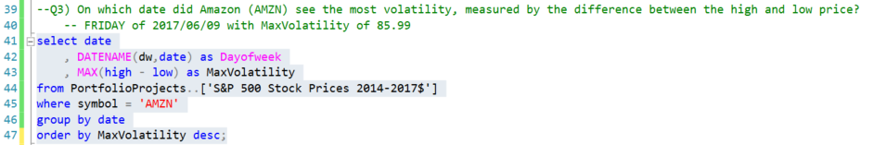
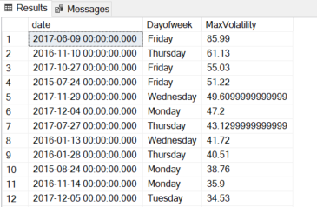
On which date did Amazon (AMZN) see the most volatility, measured by the difference between the high and low price?
Breakdown of the query
- select the date
- select the day from date. Use DATENAME() function to extract the day of the week.
- Rename aggregate DATENAME(DW, date) as Dayofweek
- calculate MaxVolatility = MAX(high - low)
- select MaxVolatility
- from dataset [‘S&P 500 Prices 2014-2017$’]
- located in database PortfolioProjects
- filter using where symbol is ‘AMZN’
- group the result by date
- order the result by MaxVolatility in descending order

Slide 8
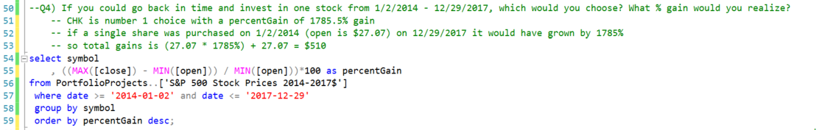
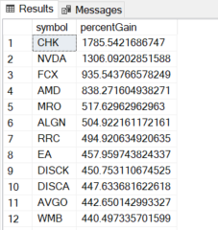
If you could go back in time and invest in one stock from 1/2/2014 - 12/29/2017, which would you choose? What % gain would you realize?
Breakdown of the query
- select the symbol.
- calculate percentGain = ((MAX([close]) – MIN([open ])) / MIN([open]))*100
- select percentGain
- from dataset [‘S&P 500 Prices 2014-2017$’]
- located in database PortfolioProjects
- filter using where date is >= ‘YYYY-MM-DD’ and date <= ‘YYYY-MM-DD’
- group the result by symbol
- order the result by percentGain in descending order

Slide 9
Findings
On March 21st, 2014, a total trading volume of 7,223,983,122 was recorded. This was the highest total trading volume recorded
On March 21st, 2014, a total trading volume of 312,052,582 and 194,754,684 were recorded for the stocks BAC and CSCO, respectively. These were the stocks with the highest total trading volume on said date.
On Fridays we have the highest average trading volume. While Mondays have the least
On June 9th, 2017, Amazon stock (AMZN) recorded the highest volatility of 85.99.
Going back in time would make me exponentially rich because a stock like CHK recorded the highest percentage gain of 1785.5%

Slide 10
THANKS FOR READING

